Slide 1
FIRE EXTINGUISHER BOT
Using ROS and Gazebo

Slide 2
What is ROS and Gazebo simulator
The Robot Operating System (ROS) is a set of software libraries and tools that help you build robot applications. From drivers to state-of-the-art algorithms, and with powerful developer tools, ROS has what you need for your next robotics project. And it's all open source.
Gazebo is a 3D dynamic simulator with the ability to accurately and efficiently simulate populations of robots in complex indoor and outdoor environments. While similar to game engines, Gazebo offers physics simulation at a much higher degree of fidelity, a suite of sensors, and interfaces for both users and programs

Slide 3
Description
We have to create an autonomous fire extinguisher bot using Robot Operating System (ROS) and Gazebo software for simulation.
We detect the fire using image-processing and detection using open-cv2. After detecting it our bot uses SLAM algorithm to reach the target area using g-mapping.

Slide 4
What’s the need?
In recent times fire accidents are increasing rapidly. Firefighting and rescue, is very dangerous for firefighters engaged in the field. So robots have been introduced to do the same. However, Robots mobility is limited so it is difficult for them to directly approach fire sources. Here we proposed a solution by designing an autonomous firefighting robot with help of Fire detection using OpenCV.

Slide 5
Some algorithms that we have used
SLAM (simultaneous localization and mapping) is a method used for autonomous vehicles that lets you build a map and localize your vehicle in that map at the same time. SLAM algorithms allow the vehicle to map out unknown environments.
The GMapping package, to create maps while our robot navigates in a given environment.
The gmapping package provides laser-based SLAM (Simultaneous Localization and Mapping), as a ROS node called slam_gmapping. Using slam_gmapping, you can create a 2-D occupancy grid map (like a building floorplan) from laser and pose data collected by a mobile robot.

Slide 6
Image Processing and Detection
Image processing is a method to perform some operations on an image, in order to get an enhanced image or to extract some useful information from it. It is a type of signal processing in which input is an image and output may be image or characteristics/features associated with that image

Slide 7
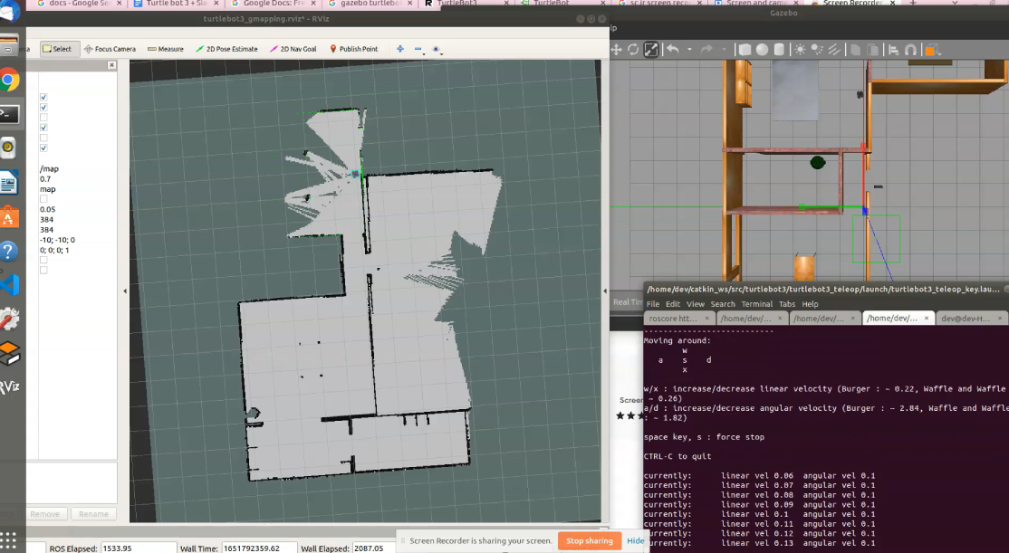
Working Demo
.

Slide 8
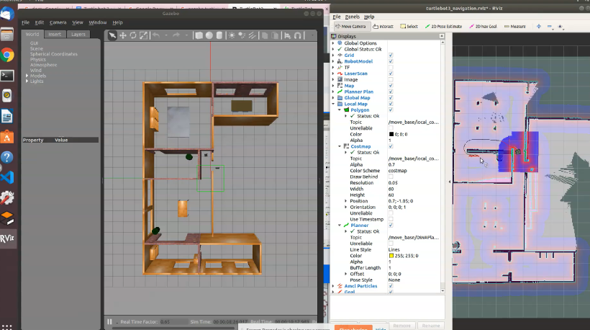
Working Demo
.

Slide 9
Problems
1) Our major problem is about the installation of ubuntu software in Dual-boot.
Soln.: at last we used Oracle VM VirtualBox
2) Another problem is the errors while running the code.
Soln.: It took time but we have done it (debugging) using some help of our mentor Baldeep Sir

Slide 10
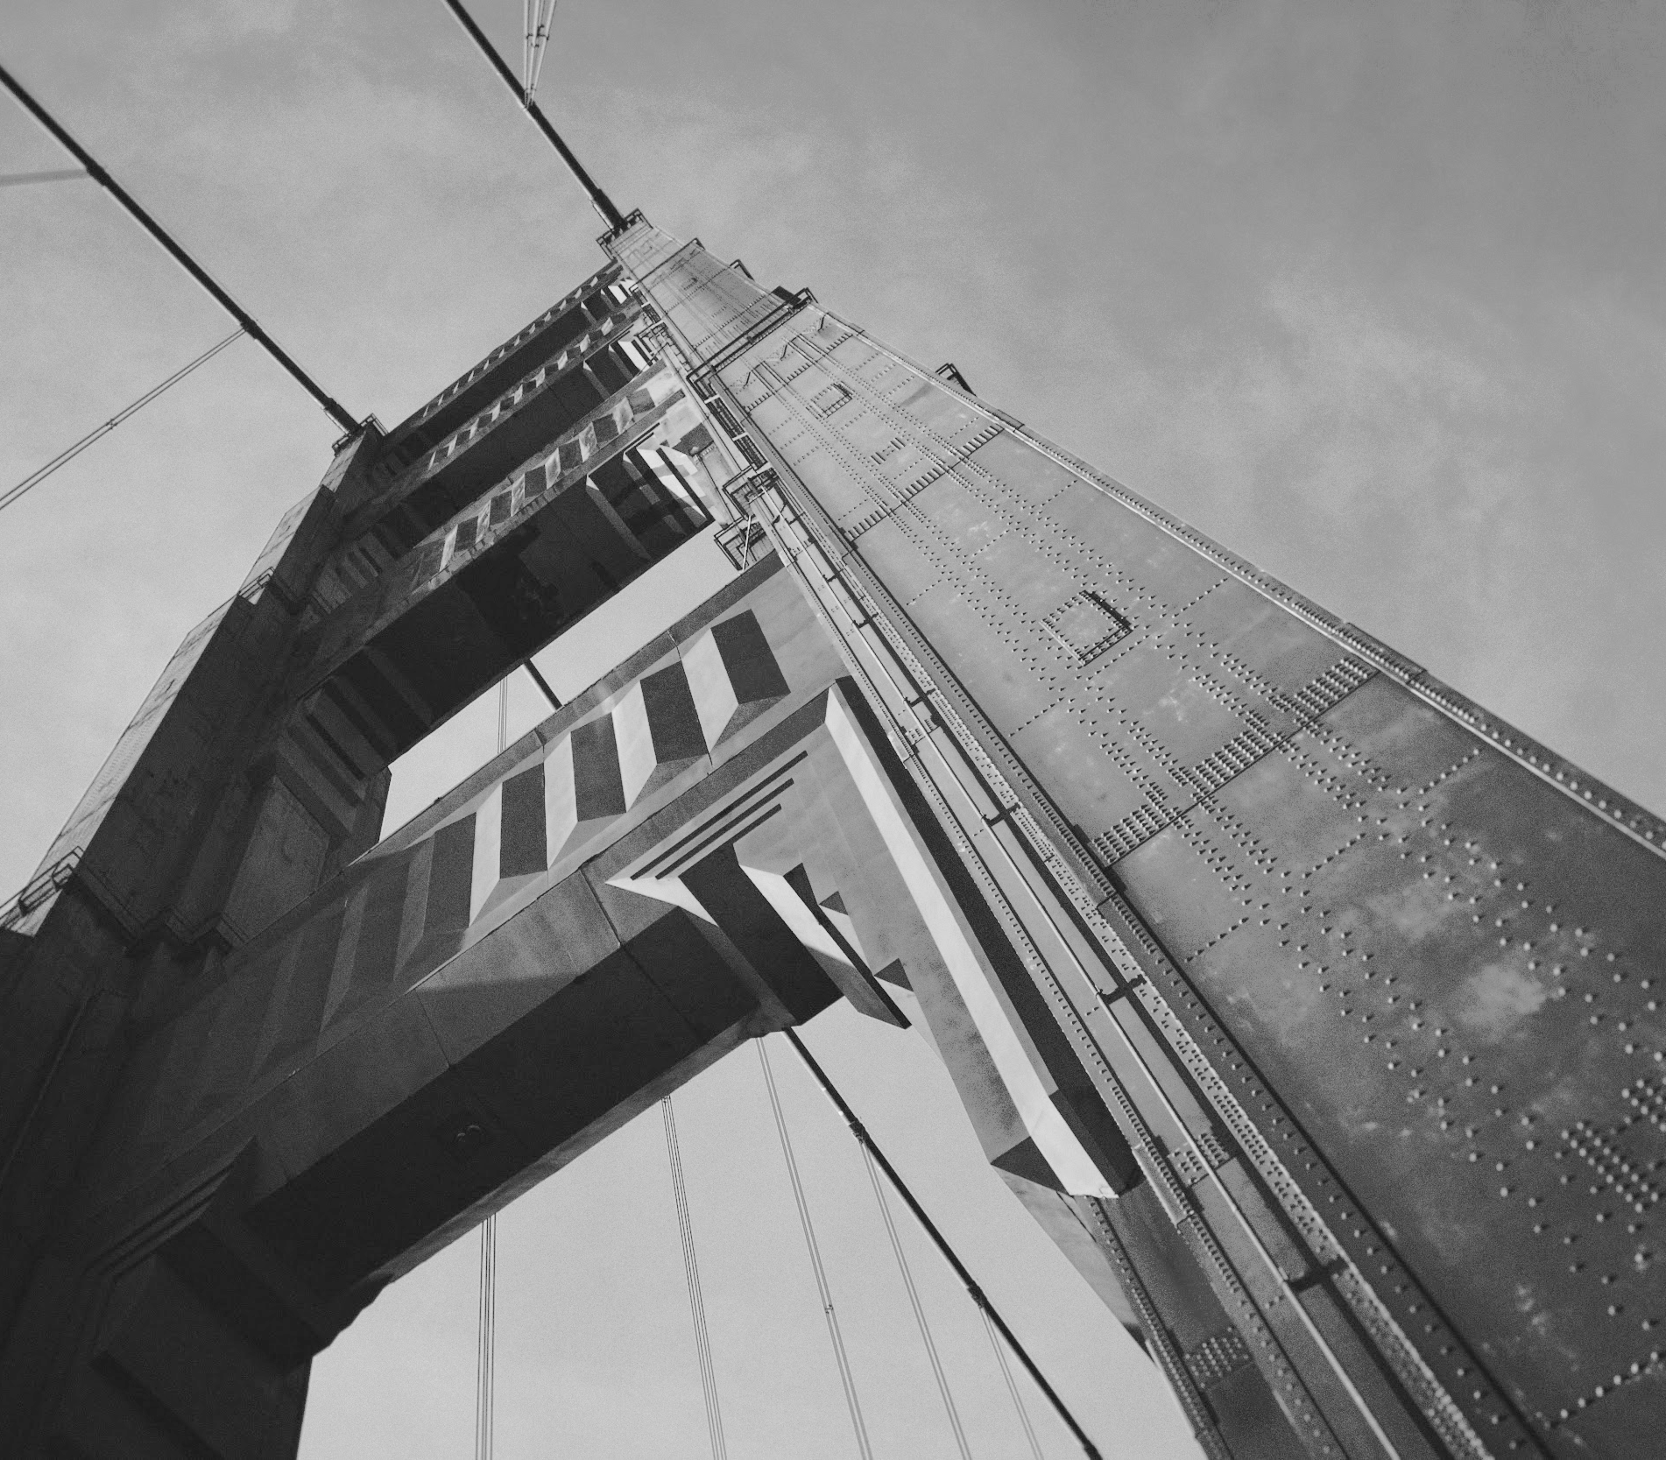
Thanks!
Krishn Bhushan Singh(2nd year EE)
Lakshit Sharma(2nd year EE)
Dev Raj Jain(2nd year ECE)
Rishabh Dubey(2nd year EE)
Our mentor
Baldeep Sir (3rd year EE)

